Slide 1
Intermediate Payroll Session
Presented by Trish Muir, Payroll Manager

Slide 2
Topics to Be Presented
Current Information for HRMS
FY19 Budget Rollover to HRMS
Effect of Additional Pays on Dept Budget Table
Department Queries
HRMS Review
HRMS Access for Departments
Campus Address Information Update
Department Reports
Department Budget Table
Retroactive Distribution Requests
Department Queries

Slide 3
Budget Rollover to Department Budget Table
Each year the funding sources and amounts for all positions is overwritten by the Budget Office
Departments can change the funding sources by submitting a Position Funding Form
Always use percentages when changing funding sources

Slide 4
How Budget Overrides Payroll 12 Month Employee
If the employee has elected to be paid over 12 months their entire year’s benefits are charged to department funding during the academic year.
The employee’s earnings/benefits are paid out of a clearing fund (HEP earnings code) when the employee is off contract.
When the budget rolls the new funding will take effect when the employee’s new contract starts for the new academic year.
Submit Position Funding Forms as early as possible.

Slide 5
How Budget Overrides Payroll Academic Year Employee
If the employee has elected NOT to be paid over 12 months then they receive earnings during their contract period only. They will, however, still will receive benefits.
When the Budget rolls effective 7/1 the employee’s benefits will be charged to the new funding that rolled in the budget. The employee’s salary will be charged to the new funding when their next new contract starts.
Budget Roll does NOT impact Additional Pay funding if there is an overriding funding source on the Additional Pay.
Submit Position Funding Forms as early as possible if necessary

Slide 6
Additional Pay from Same Funding Source as Base Salary
For Employees with Base funding being paid from multiple funding sources:
Be Aware of potential problem with Additional Pays that are paid from same funding source as regular salary only when amounts are in Department Budget table
Always submit position funding forms using percentages even though the budget rolls using dollars

Slide 7
HRMS QUERIES
Query Viewer:
Main Menu→Reporting Tools→Query→Query Viewer
Query Pages:
Main Menu→Reporting Tools→Query→HE Query Pages
Examples:
NDU_PY_HOURS_WORKED
NDU_PY_HOURS_WORKED_DTL
NDU_PY_HOURS_WORKED_SUM
NDU_HR_ORG_PLUS_LIST

Slide 8
Recommended HRMS Query
NDU_CA_GROSS_FRNG_TFUND_ACCPER
Provides listing of employees, salary, ER benefits and taxes, by funding source, for specified period and optional by employee
See Section 7 of HRMS Department Payroll Queries Handout
Excellent query for providing salary backup documentation by funding source for a period of time.
One day after Payroll Confirm all data will be available on the Gross & Fringe report.

Slide 9
Halftime
Short Break before Payroll Intermediate Session continues
Payroll Intermediate Session will include:
HRMS Access for Departments
Campus Address Information Update
Department Reports
Department Budget Table
Retroactive Distribution requests

Slide 10
HRMS Access for Departments
HRMS Security Access form is located on the Human Resources website>Forms>HRMS Access Request
Complete Personal information at top of form
Enter department number for Row Level Data Permission
Employee’s Supervisor must email the completed form to Trish Muir for processing. Security officers cannot accept hard copy request forms.

Slide 11
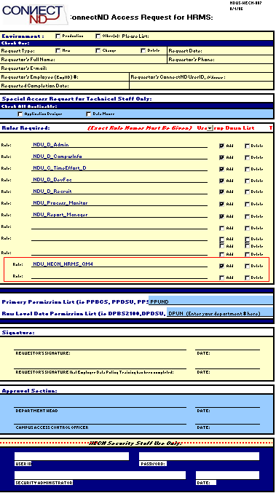
Personal information of employee for who access is requested
Enter your department number next to DPUN
Type Requestor’s Name for Signature
Supervisor should type their name in Approval Section and forward form via email as an attachment.

Slide 12
HRMS Access Restricted
Departments may not have access to HRMS during Payroll Confirm (Final Processing)
Access may be restricted:
3:00 on pay confirm day until the following morning.
A Payroll calendar is available under the Manager’s Toolbox on the website.
After Confirm, Gross and Fringe Data is available for all payrolls.

Slide 13
Campus Address Update
Department HR Contacts are responsible to review Campus Addresses for department employees for accuracy, completeness and standardization.
Campus Address Query should be run once per quarter to verify addresses for all employees-
NDU_HR_CAMPUSADDRESSPHONEEMAIL

Slide 14
Department Reports
Payroll Register Report
Run 4-5 days prior to pay day
Report payment discrepancies to Payroll immediately
HE Actuals Distribution Report
Run 2 days prior to pay day
Report funding discrepancies to Payroll immediately
Gross and Fringe Report
Can be run 1 day after pay confirm to reflect the most recent payroll or anytime when necessary for past pay periods
If you do not receive Email notifications when reports are ready, please email trish.muir@und.edu to request to be added to the HRMS Listserv.

Slide 15
Retroactive Distributions
3 Ways to Avoid Retroactive Distributions:
Submit Position Funding Forms prior to deadline for pay period being paid
Run Pay Register and report discrepancies
Run HE Actuals Distribution Report - 3 days prior to pay day - report discrepancies via fax with correction requests prior to 2:00 pm - 3 days prior to pay day

Slide 16
Types of Retroactive Distributions
Full Retroactive Distribution
When all salary charged to one funding source should be transferred to another funding source.
Partial Retroactive Distribution
When only a portion of salary charged to a funding source should be transferred to another funding source OR
When the funding charged to a funding source should be transferred to multiple funding sources.

Slide 17
Completion of Retroactive Distribution Forms
Full Retrodistribution Request
Completion of a Retroactive Distribution Request Form
Copy of HE Actuals Distribution showing the charge to the original funding source
Partial Retrodistribution Requests
Completion of a Retroactive Distribution Request Form
Copy of HE Actuals Distribution showing the charge to the original funding source for each pay period correcting for the employee
Completed Retro Partial Salary Correction form(s) for each payroll correcting

Slide 18
TLAB – Time & Labor/Absence Management
Time & Labor
Replaces all paper forms once used to submit hours worked, overtime/comp time for non exempt employees, or any other hours that were submitted on an Hourly Reporting Form
Absence Management
Replaces all paper forms once used to submit hours taken for any kind of leave. Examples: annual, sick, or jury duty leave

Slide 19
Questions?
Further discussion of any topics
Questions on other topics
Suggestions for future topics

